Slide 1
Dataset Element Automation
Prototype

Slide 2
Updating Business Datasets
Currently updating Business Datasets is a manual process. In the web interface, a user needs to add element by element. The solution I’ve created have these features:
Modify a config file to provide a list (including wildcards) of technical elements to associate to Business Datasets.
Allow for criteria, like only include if the element has a Busines Name and/or a Business Term
Also allow for bulk deleting of element associations
Also allow for Business Dataset to Business Dataset lineage

Slide 3
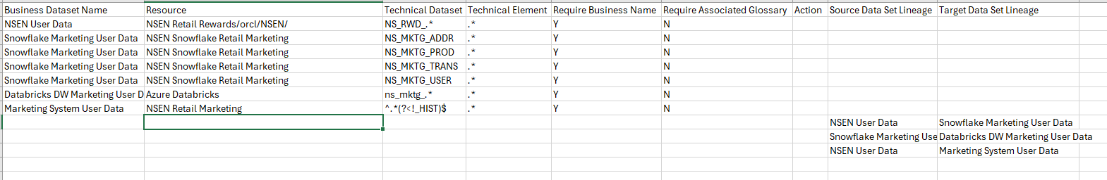
Configure with config.csv
Provide the name of the Technical Dataset (table, view, filename, etc). This can be a simple name, wildcards, or Regular Expression
Provide the Business Dataset Name (must be created already)
Provide Y/N flag on weather the element in question needs to have a Business Name to be included
Optional. If deleting an association, fill in with DELETE. Otherwise, the behavior will be to create the association
Optional. If adding lineage, provide the Target Business Dataset Name
Provide the Resource Name that contains the Dataset to be added. Can also be a “path”, such as database, schema, folder, etc
Provide the name of the Technical Element (column, field, etc) that exists in the dataset. This can be a simple name, wildcards, or Regular Expression
Provide Y/N flag on weather the element in question needs to one or more glossary terms associated to be included
Optional. If adding lineage, provide the Source Business Dataset Name

Slide 4
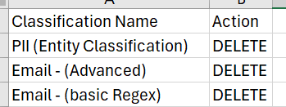
Other Options
Script can also be made to extract existing Classifications. By default, it’ll only do this when it’s needed (setting up Entity Classifications, for example). You can force the extract with a command line parameter
Deleting Classifications are done by executing a job. You can execute them in bulk by formatting a simple csv file (classifications_delete.csv by default) with the Classification Name, and Action (set to DELETE). You can run the script with a delete command line parameter, and optionally the csv file that contain the classifications to be deleted.
python simple_classification_creator.py extract
python simple_classification_creator.py delete python simple_classification_creator.py delete my_delete_file.csv

Slide 5
Additional Information
By default, the script will look for a config.csv file, you optionally, you can also pass the name of your csv file as a command line parameter. For example:
Additional flags can be set on the script:
default_pod. Set this to the default Informatica POD to use. Example: dm-us
default_user. Set this to the default user to use. Example: shayes_compass
default_pwd. Set this to the default password to use. Example: 1234
prompt_for_login_info. True/False. Whether or not to prompt. If False, will not prompt, unless default is not set
pause_before_loading. True/False. Whether or not to pause after payload files are created, before loading the classifications.
show_raw_errors. True/False. If set to True, it will always show raw errors if they occur. Otherwise, it will attempt to find the message from the error, and display that.
If desired, you can create a credentials.json to save your defaults in ~/.informatica_cdgc path. Example of that file is:
python update_datasets.py my_config.csv
{ "default_pod": "dmp-us", "default_user": "shayes_compass", "default_pwd": “xxx" }

Slide 6
Output
Sample Output:
Note that if an error occurs, it will skip that association and continue
> python update_datasets.py INFO: Cleaning up data INFO: Loading preliminary data Enter pod (default: dmp-us): Enter username (default : shayes_compass): Enter password: INFO: Loading data for "NSEN Retail Rewards" INFO: Looking at appropriate elements in: NSEN Retail Rewards/orcl/NSEN/NS_RWD_USER INFO: Queuing Insert Element in "NSEN User Data": RWD_CARD_EXP_DATE | Business Name: Credit Card Expiration | Terms: ['Credit Card Expiration'] INFO: Queuing Insert Element in "NSEN User Data": RWD_USER_ID | Business Name: Account ID | Terms: ['Account ID'] INFO: Queuing Insert Element in "NSEN User Data": USER_NAME | Business Name: Username | Terms: ['Username'] INFO: Queuing Insert Element in "NSEN User Data": RWD_BIRTH_DATE | Business Name: Date Of Birth | Terms: ['Date Of Birth'] INFO: Queuing Insert Element in "NSEN User Data": RWD_FIRST_NAME | Business Name: First Name | Terms: ['First Name'] Press Any Key to load ... INFO: Publishing Element in "NSEN User Data": RWD_CARD_EXP_DATE INFO: Publish successful INFO: Publishing Element in "NSEN User Data": RWD_USER_ID INFO: Publish successful INFO: Publishing Element in "NSEN User Data": USER_NAME INFO: Publish successful INFO: Publishing Element in "NSEN User Data": RWD_BIRTH_DATE INFO: Publish successful INFO: Publishing Element in "NSEN User Data": RWD_FIRST_NAME INFO: Publish successful

Slide 7
Thank You
Questions / Issues / Suggestions:
Scott Hayes
shayes@informatica.com

